Slide 1
Just Right
SDC HACKATHON 2026 · DOMAIN 2 · ORBYTE SMART SME
An AI bake planner that tells small bakeries how much of each item to bake tomorrow.
Team Beginathon · Derek Chay Wen Hong & Tan Jun Hao · Multimedia University, Cyberjaya
Notes:
Hi, we are team Beginathon from MMU Cyberjaya. Our project is Just Right, an AI bake planner that tells a small bakery or café how much of each item to bake tomorrow.

Slide 2
6,000 tonnes
EVERY SINGLE DAY IN MALAYSIA
of food that could still be eaten is thrown away. That’s about 240 lorry loads, every day.
Source: SWCorp data for 2025, reported by New Straits Times, 15 June 2026 (up from about 5,000 tonnes a day in 2024).
Notes:
Every single day, Malaysians throw away about 6,000 tonnes of food that could still be eaten. That’s around 240 lorry loads, every day, and it went up from about 5,000 tonnes the year before.

Slide 3
A lot of it is baked, never sold, and thrown out by the shop
WHERE BREAD WASTE STARTS
Up to 35%
Guessing
of bread waste happens in bakeries and shops, before it reaches anyone’s home.
Bakeries name hard-to-forecast demand and wrong order quantities as main causes.
Nofima research, Norway (FoodNavigator, Jan 2024)
Study of 19 bakeries, SLU Sweden (2021)
We couldn’t find any published figure for Malaysian bakeries. So we went to ask them ourselves.
Notes:
And bread is a big part of the story. Research from Norway found that up to 35 percent of bread waste happens in bakeries and shops, before the bread even reaches a home. When researchers asked bakeries why, they pointed to the same thing: demand is hard to predict, so they guess, and order quantities end up wrong. We couldn’t find any published numbers for Malaysian bakeries, so we went to ask them ourselves.

Slide 4

So we went and asked the people who bake
FIELD RESEARCH
We visited three bakeries and talked to the staff: how they decide how much to bake, and what happens to what’s left.
At La Boheme, with one of the bakers we spoke to
Notes:
So we did. Here’s our team at La Boheme with one of the bakers who took the time to talk to us. We visited three bakeries and asked the staff two questions: how do you decide how much to bake, and what happens to the bread that doesn’t sell?

Slide 5
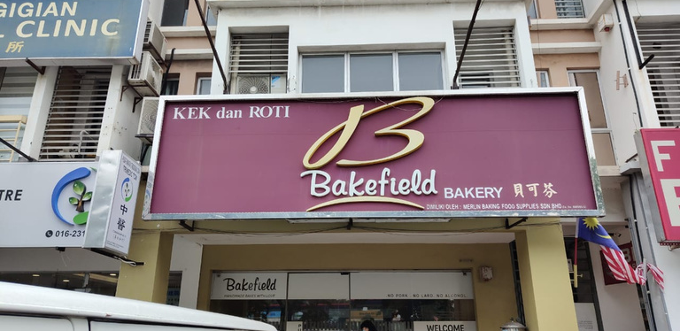
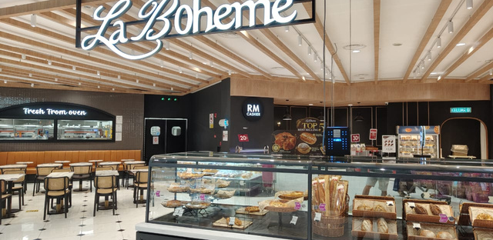
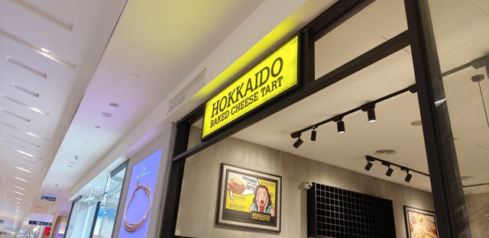
We visited three bakeries
WE ASKED THE PEOPLE WHO BAKE
Bakefield (independent)
La Boheme (chain)
Hokkaido (chain)
Don’t know how to work out quantities, so they estimate. Leftovers get a small discount at closing.
Follow company policy using past quantities and sales. Still discount unsold bread every day.
Bake a fresh batch when one sells out. Unsold stock goes back to the factory.
Chains have policies and factories to fall back on. Independent bakeries have thin margins and only a guess.
Notes:
Here’s what the three bakeries told us. At Bakefield, an independent bakery, they told us they don’t know how to calculate how much to bake, so they estimate, and give a small discount on leftovers at closing. La Boheme is a chain: they follow a policy based on past quantities and sales, but they still discount unsold bread every day. Hokkaido bakes a new batch when one sells out and sends leftovers back to their factory. So the chains have systems and backing. The independent bakery, with thin margins, is just guessing. That is who we built for.

Slide 6
Every evening, a small bakery guesses how much to bake tomorrow.
WHAT WE LEARNED
Bake too much
Bake too little
No tools to help
Unsold bread is discounted at closing or thrown away.
Shelves empty by lunch, and customers leave without buying.
Owners use rule of thumb. No analyst, no forecasting.
The waste isn’t careless staff. It’s poor planning, because nobody gives them a better way to decide.
Notes:
So here’s what we learned. Every evening, a small bakery guesses how much to bake tomorrow. Bake too much and the leftovers are discounted or thrown away. Bake too little and the shelves are empty by lunch, and customers walk out. They have no analyst and no forecasting tool, only rule of thumb. The waste isn’t because staff don’t care. It’s a planning problem.

Slide 7
The goal is the right amount of waste, not zero.
THE KEY INSIGHT
RM 2
RM 6
lost when a croissant is thrown away (its cost)
lost when a customer can’t buy one (the profit)
Notes:
Here is the key insight. The two mistakes don’t cost the same. If a croissant is thrown away, you lose about RM 2, its ingredient cost. If you run out and a customer can’t buy one, you lose about RM 6 of profit. So zero waste is actually the wrong goal. Baking a little extra of a high-margin item is worth it. Just Right finds the right amount for each item.

Slide 8
A daily loop on Telegram, the app staff already use
OUR SOLUTION
01
02
03
04
Closing count
AI plans
Manager approves
Baker bakes
Staff tap in what’s left of each item, and roughly when anything sold out.
The model learns from history and weather and picks tomorrow’s quantity, with a reason.
At 2 PM the manager gets the plan and taps Approve or Edit. Only the manager can.
The baker receives the final list and bakes just the right amount.
Every action is logged, and the manager sees waste in RM on a web dashboard.
Notes:
Just Right is a Telegram bot plus a web dashboard. We chose Telegram because staff already have it on their phones, so there is nothing new to install. Step one: at closing, staff tap in how many of each item are left, and if something sold out, roughly what time. Step two: overnight, the AI learns from that and plans tomorrow’s quantity for each item, with a plain-language reason. Step three: at 2 PM the manager gets one message with the plan and taps Approve or Edit. Only the manager can do this. Step four: the baker gets the final list. Everything is logged, and the manager can see waste in ringgit on a dashboard.

Slide 9
It learns each shop’s own pattern, every night
HOW THE AI WORKS
Forecast demand
A machine-learning model (scikit-learn) per item, using weekday and live weather from Open-Meteo. Retrains every night.
SELF-CHECK
2.4
Counts hidden demand
A sell-out at 11 AM means people wanted more. We scale demand up by how early it sold out.
pieces off per item per day, vs 3.2 for a plain 28-day average
Picks a safe quantity
A newsvendor rule uses price and cost to choose the amount. Changes are capped at ±15% a day.
On simulated sample data
Notes:
How does the AI work? First, for each item a small machine-learning model learns how demand depends on the day of the week and the weather, using live forecasts from Open-Meteo. It retrains every night, so it picks up each shop’s own pattern. Second, when an item sells out early, sales understate what people wanted, so we scale demand up based on how early it ran out. Third, a newsvendor rule uses the price and the cost to pick the quantity, and we cap changes at 15 percent a day so the plan never jumps wildly. The model also checks itself: on our sample data it misses by about 2.4 pieces per item per day, compared to 3.2 for a simple average. That data is simulated, so this shows the method, not real shop results.

Slide 10
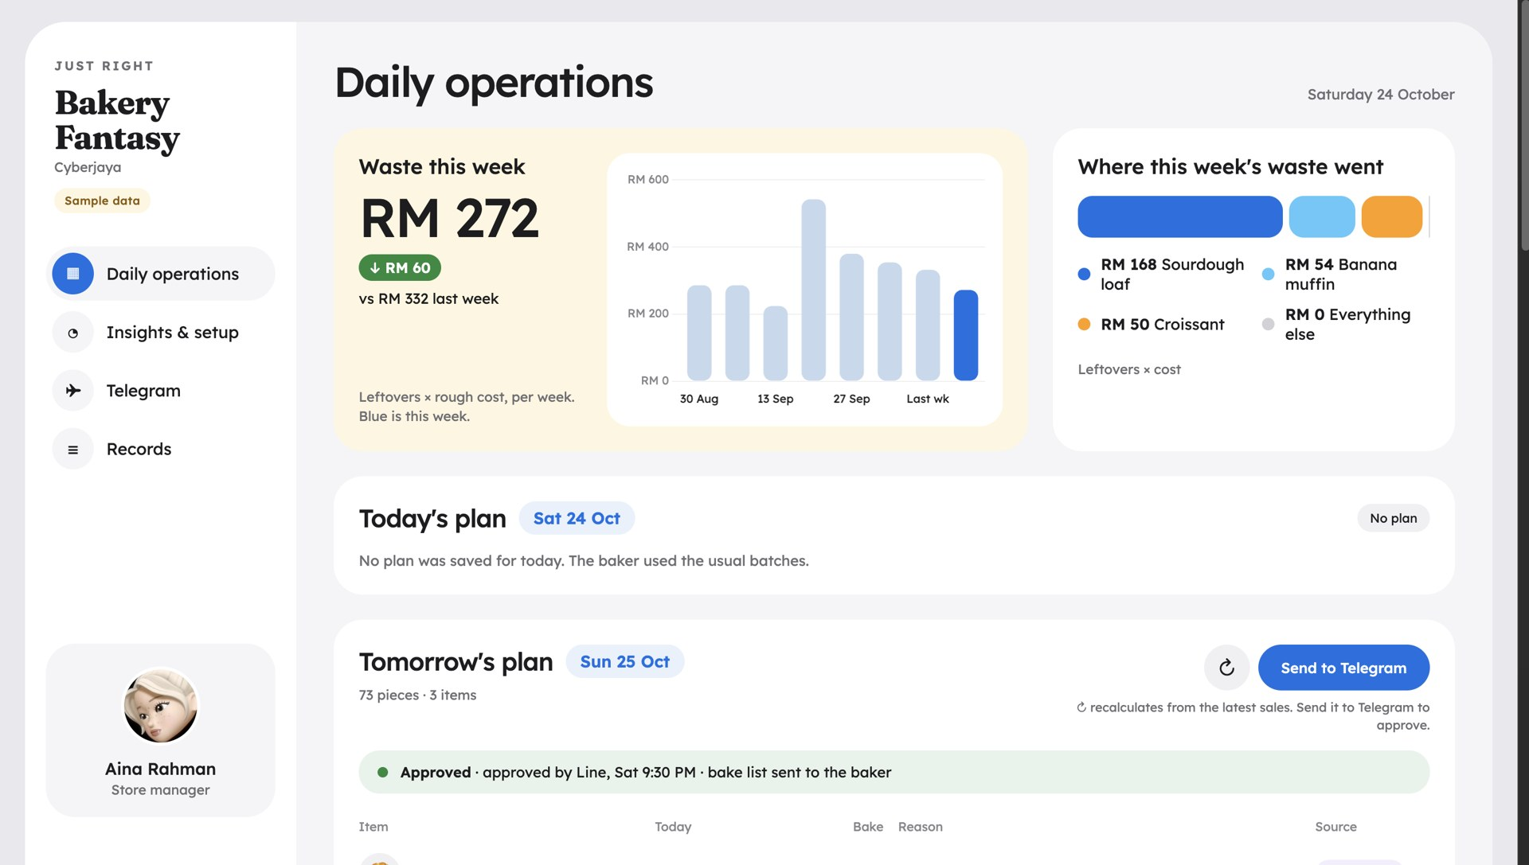
The manager’s dashboard
LIVE DEMO
just-right-linegidid.replit.app · Telegram: @justright_bakery_bot · sample data
Notes:
Here is the manager’s dashboard, live on Replit. It shows the waste this week in ringgit and what caused it, today’s plan, and tomorrow’s plan and whether it has been approved. Now let me show it working on Telegram. [Switch to the screen recording: send /plan, show the plan with reasons, tap Approve, show the baker receiving the list, then the activity log on the dashboard.]

Slide 11
Less waste, fewer sell-outs, better margins
IMPACT
BASELINE
TARGET
SDG
RM 340
−20%
SDG 8 & SDG 12
8.2 productivity for small businesses through technology · 12.3 halve food waste at retail by 2030
wasted per week by baking the usual fixed batch (sample bakery, 3 items)
weekly food waste in RM, with no increase in sell-outs
Notes:
For impact: in our sample bakery, baking the usual fixed batch wastes about RM 340 a week across three items. Our target is 20 percent less waste in ringgit, without more sell-outs. This supports SDG 8, target 8.2, helping small businesses become more productive with technology, and SDG 12, target 12.3, halving food waste at the retail level by 2030.

Slide 12
Simple, cheap to run, always on
HOW IT’S BUILT
Part | What we used
Chat interface | Telegram bot (pyTelegramBotAPI), staff and manager roles
AI forecast | Python, scikit-learn, NumPy, Open-Meteo weather
Dashboard & API | Flask, SQLite, APScheduler for the 2 PM plan
Hosting | Replit Deployments (Reserved VM, Asia), Replit Secrets
Orbyte | Built as an Orbyte-style module; POS data simulated
Notes:
The tech stack is deliberately simple. The bot uses pyTelegramBotAPI. The forecast is Python with scikit-learn and free weather from Open-Meteo. The dashboard is Flask with SQLite, and a scheduler sends the plan at 2 PM. It all runs as one always-on app on Replit Deployments, with our tokens kept in Replit Secrets. It is designed as a module for Orbyte; for the hackathon the POS sales data is simulated.

Slide 13
Bake just right.
Thank you.
WHAT’S NEXT
Pilot
Live POS sync
More shops
Run it with a real independent bakery for a month.
Read real sales from Orbyte instead of sample data.
Cafés, kuih stalls and other fresh-food SMEs.
Team Beginathon · github.com/derkglova/just-right · t.me/justright_bakery_bot
Notes:
Next, we want to pilot Just Right with a real independent bakery for a month, connect live sales from Orbyte’s POS instead of sample data, and extend it to cafés, kuih stalls and other fresh-food businesses. Small bakeries shouldn’t have to guess. Thank you, we are team Beginathon.

